Slide 1
ATOM Modelling PipeLine (AMPL) Tutorial
Titli Sarkar
Frederick National Lab for Cancer Research

Slide 2
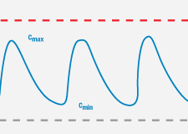

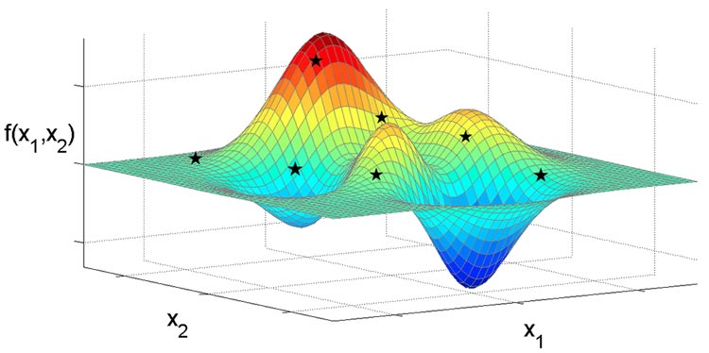


The ATOM Platform
Active Learning Drug Discovery Framework
Machine Learning Pipeline
Efficacy
Multi-Parameter Optimization Loop
Property prediction models
Systems models
Safety
Working
Compound
Library
PK
Design Criteria
Developability
Generative Molecular Design
proposes new molecules with optimized properties
Active learning decides if/when a simulation or experiment is needed to improve or validate models
Retrain property prediction models
Molecular Feature
Simulations
Simulation
Human-relevant assays, complex in vitro models
Chemistry Design & Synthesis
Experiment

Slide 3
Agenda
Why AMPL?
Open Source
Active development
Collaborative effort
Supporting pages
You can bring in your own python package and use it along-side AMPL
Goal for Today
Data Ingestion + Curation
Featurization
Visualization
ML-ready datasets
ML modeling
Analysis
https://github.com/ATOMScience-org/AMPL

Slide 4
AMPL: End-to-End Data-Driven Modeling Pipeline
Common infrastructure in place and ready to receive/transform new data
Curated Smiles
COc1ccc2[nH]cc(CCNC(C)=O)c2c1
NC(=O)c1cnccn1
Clc1cccc(N2CCNCC2)c1
Nc1c2c(nc3ccccc13)CCCC2
CC(=O)Nc1ccc(O)cc1
CC(=O)Nc1nnc(S(N)(=O)=O)s1
CCCSc1ccc2nc(NC(=O)OC)[nH]c2c1
CC(C)(C)NCC(O)c1ccc(O)c(CO)c1
C=CCc1ccccc1OCC(O)CNC(C)C
CC(=O)Nc1c(I)c(NC(C)=O)c(I)c(C(=O)O)c1I
CCC1(c2ccc(N)cc2)CCC(=O)NC1=O
Train/ val/ test split
Random
Scaffold
Fingerprint
Butina
Temporal
ave_min
Featurize with ECFP or molecular descriptors:
Moe
Mordred
RDKit
ECFP
GraphConv
Model
Random forest
Neural Network
XGboost
Type
Classification
Regression
Predict
Use to predict on Chemical Property e.g., pIC50 value/ Ki value of novel molecules

Slide 5
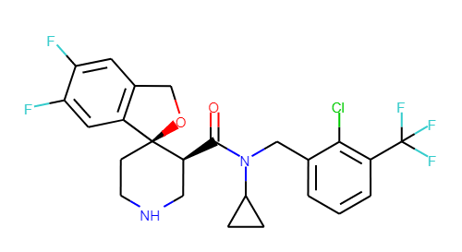
Data Input Format
Simplified Molecular-Input Line-Entry System (SMILES)
ChEMBL ID# CHEMBL1923118:
Molecular Structure of a
Cytochrome P450 3A4 (CYP3A4)
- oxidizes toxins or drugs, so that
they can be removed from the body.
O=C([C@H]1CNCC[C@@]12OCc1cc(F)c(F)cc12)N(Cc1cccc(C(F)(F)F)c1Cl)C1CC1
Canonical SMILES
https://en.wikipedia.org/wiki/Simplified_molecular-input_line-entry_system

Slide 6
Data Curation Steps
Data Ingestion
Data cleaning, tidying
Remove NaN values
Average duplicates
Remove outliers (subjective)
Pre-curation
Feature engineering
Outcome variable IC50 -> pIC50
Numerical -> categorical
Curation
Merge Databases – DTC, ChEMBL, ExcapeDB => Union
Featurization - convert varied forms of data to numerical data which can be used for basic ML algorithms.

Slide 7
Data Splitting
When evaluating a machine learning model, it’s useful to creating training, validation and test splits of your source data.
training split -> train models
validation split -> benchmark different model architectures
test split -> ideally held out till the very end when it’s used to gauge a final estimate of the model’s performance om “unseen” data
https://deepchem.readthedocs.io/en/latest/api_reference/splitters.html

Slide 8
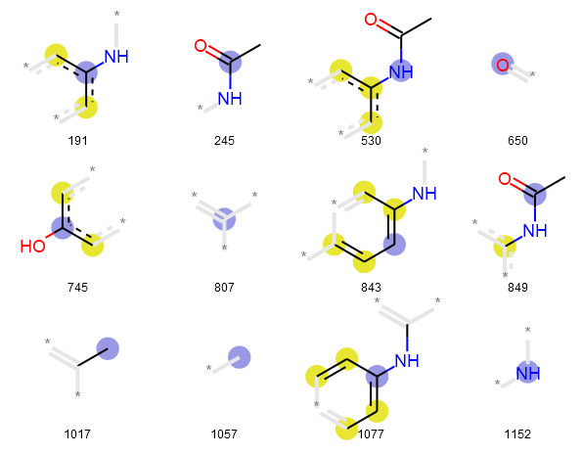
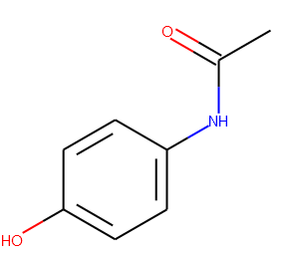
Featurizing a molecule: Fingerprints
Slide Courtesy - S. Ravichandran
Fingerprints
Molecules -> fixed-length binary vectors (0s and 1s). indicating presence/absence of certain molecular features
One can compare fingerprints of two molecules and identify similarity
CC(=O)NC1=CC=C(C=C1)O
000000000000000000000000000000000000000000000000000000000000000000000000000000000000000000000000000000000000000000000000
000000000000000000000000000000000000000000000000000000000000000000000001000000000000000000000000000000000000000000000000
000001000000000000000000000000000000000000000000000000000000000000000000000000000000000000000000000000000000000000000000
000000000000000000000000000000000000000000000000000000000000000000000000000000000000000000000000000000000000000000000000
000000000000000000000000000000000000000000000000001000000000000000000000000000000000000000000000000000000000000000000000
000000000000000000000000000000000000000000000000001000000000000000000000000000000000000000000000000000000000000000000000
000000000000000000000000010000000000000000000000000000000000000000000000000000000000000100000000000000000000000000000000
000100000100000000000000000000000000000000000000000000000000000000000000000000000000000000000000000000000000000000000000
000000000000000000000000000000000000000000000000000000000100000000000000000000000000000000000000010000000000000000000100
000000000000000000000000000000000000000000000000000000000000000000000000100000000000000000000000000000000000000000000000
000000000000000000000000000000000000000000000000000000000000000000000000000000000000000000000000000000000000000001000000
000000000000000000000000000000000000000000000000000000000000100000000000000000000000000000000000000000000000000000000000
000000000000000000000000000000000000000000000000000000000000000000000000000000000000000000000000000000000000000000000000
000000000000000000000000000000000000000000100000000000000000000000000000000000000000000000000000000000000000000000000000
000000000000000000000000000000000000000000000000000000000000000000000010000000000000000000000000001000000000000000000000
000000000000000010000000000000000000000000000000000000000000000000000000010000000000000000000000000000000000000000000100
000000000000000000000000000000000000000000000000000000000000000000000000000000000000000000000000000000000000000000000000
00000000
Paracetamol
https://github.com/ravichas/ML-predict-drugclass (additional information on Fingerprints)

Slide 9
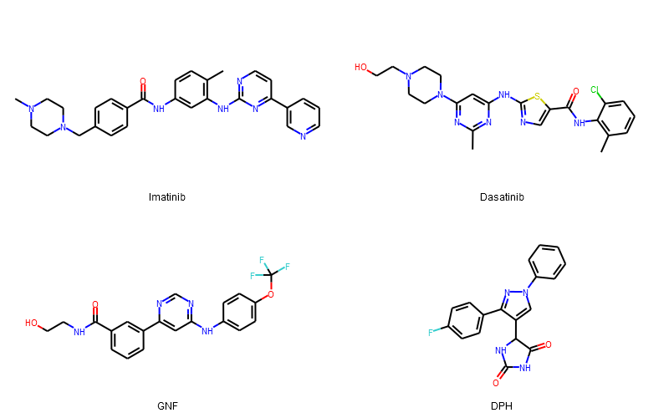
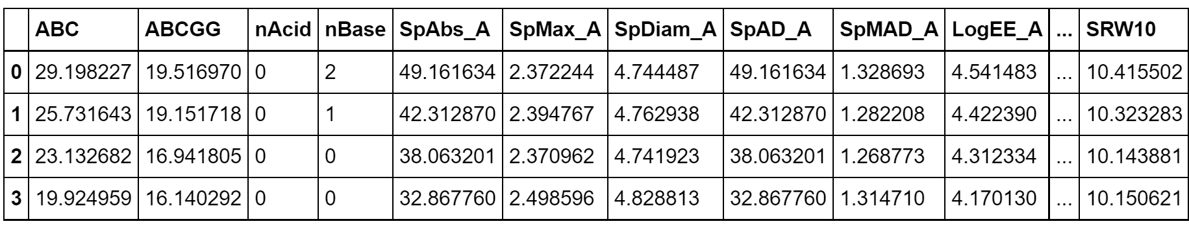
Featurizing a molecule: Molecular descriptors
Slide Courtesy - S. Ravichandran
Physicochemical properties
Molecular weight, # of Hydrogen bond donors, log partition coefficient etc.
Mordred
~1800 descriptors
Open source software
Implemented in AMPL
https://mordred-descriptor.github.io/documentation/master/descriptors.html

Slide 10
Machine Learning Algorithm
Train Data + ML algorithm + Prediction on Targets
Types:
Classification
predicting a discrete class label
"Is this email spam or not spam?” (Binary)
"Is this product a book, movie, or clothing?” (Multiclass)
Regression
predict a continuous numeric value (Linear Regression)
"What will the temperature be in Seattle tomorrow?"

Slide 11
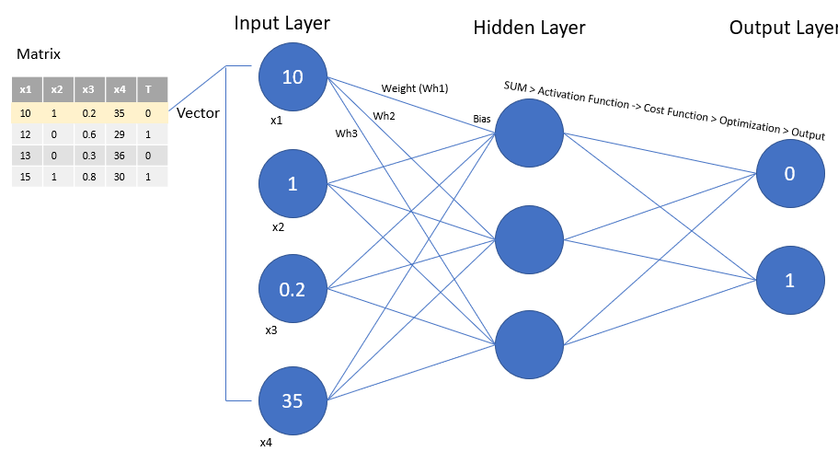
A ML Model: Neural Network
https://datascience.stackexchange.com/

Slide 12
AMPL Tutorial from Github https://github.com/ATOMScience-org/AMPL/tree/master/atomsci/ddm/examples/tutorials
Install AMPL (in Colab)
Data Curation using AMPL
Read data .csv files as Pandas Dataframe format
Generate a standardized SMILES, InChI keys for dataset with curation and structure modules.
# RDkit modules are used to process the SMILES strings
Visualize molecules using Rdkit
Train & Store models
• Random Forest
• Neural Network
• XGBoost
Compare models using AMPL
Prediction on unseen new target molecules using "predict_results" returned from pfm.predict_from_model_file()
Prediction
Learn to store & read models
Use to predict on novel molecules

Slide 13
Comparing Models Trained with AMPL Slide Courtsey – Joseph Ivanic
Prediction
Tutorial 10:
Trained & stored models – Further analysis of predicted vs. actual data
shows XGBoost overfits on training set
• Random Forest
• Neural Network (best model)
• XGBoost
Learn to store & read models
Use to predict on novel molecules
Random Forest
Neural Network
XGBoost
• Train: R² = 0.9892
• Valid: R² = 0.6682
• Test: R² = 0.7759
• Train: R² = 0.9494
• Valid: R² = 0.7926
• Test: R² = 0.8369
• Train: R² = 0.9995
• Valid: R² = 0.7587
• Test: R² = 0.7723
Actual
Predicted
Predicted
Predicted

Slide 14


Computing Environments
This Photo by Unknown Author is licensed under CC BY-SA-NC
COLAB | GCP
Serverless | Serverless
Resources are !unlimited and !guaranteed | Extra resource on demand, subject to approval by NIH
Browser-based | API-based
Good for short jobs; explaining AMPL capabilities | Good for jobs requiring huge amount of resource
Audience: Interns, Workshop attendee (Educational) | Audience: Interns, Workshop attendee (Educational)

Slide 15
Action Items
Reading exercise to get started with AMPL:
AMPL on GitHub: https://github.com/ATOMconsortium/AMPL
Basic Colab Tutorial: https://github.com/ATOMScience-org/AMPL/blob/master/atomsci/ddm/examples/tutorials/00_BasicCOLAB_Tutorial.ipynb
AMPL Examples: https://github.com/ATOMconsortium/AMPL/tree/Tutorials/atomsci/ddm/examples/tutorials
Molecular Docking on AutoDock tutorial: https://colab.research.google.com/github/pb3lab/ibm3202/blob/master/tutorials/lab06_docking.ipynb

